Slide 1

Introduction to Web
By Prof Vaibhavi Patel

Slide 2

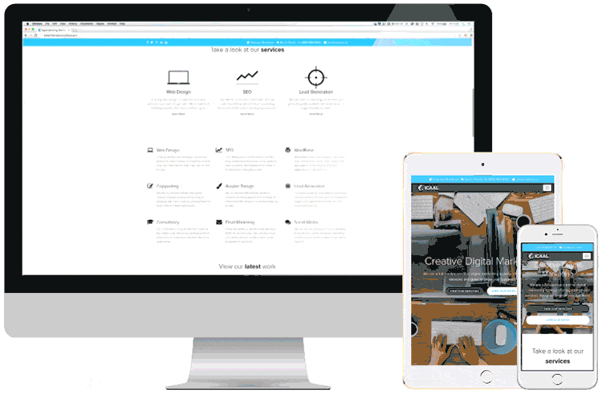
Internet vs Web

Slide 3
WWW
WWW is stands for World Wide Web.
Different between Internet and WWW
The Internet is a global system of interconnected computer networks. In contrast, the World Wide Web is one of the services transferred over these networks. It is a collection of text documents and other resources, linked by hyperlinks and URLs, usually accessed by web browsers, from web servers.
The Web is a Portion of The Internet. The Internet is also used for email, which relies on SMTP, instant messaging and FTP. So the Web is just a portion of the Internet.
There are several applications called Web browsers that make it easy to access the World Wide Web; For example: Firefox ,Microsoft's Internet Explorer, Chrome , Safari, Opera Etc.

Slide 4
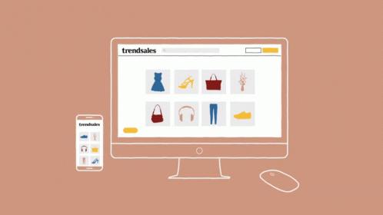
What is website?
Is a set of related web pages located under a single domain name

Slide 5
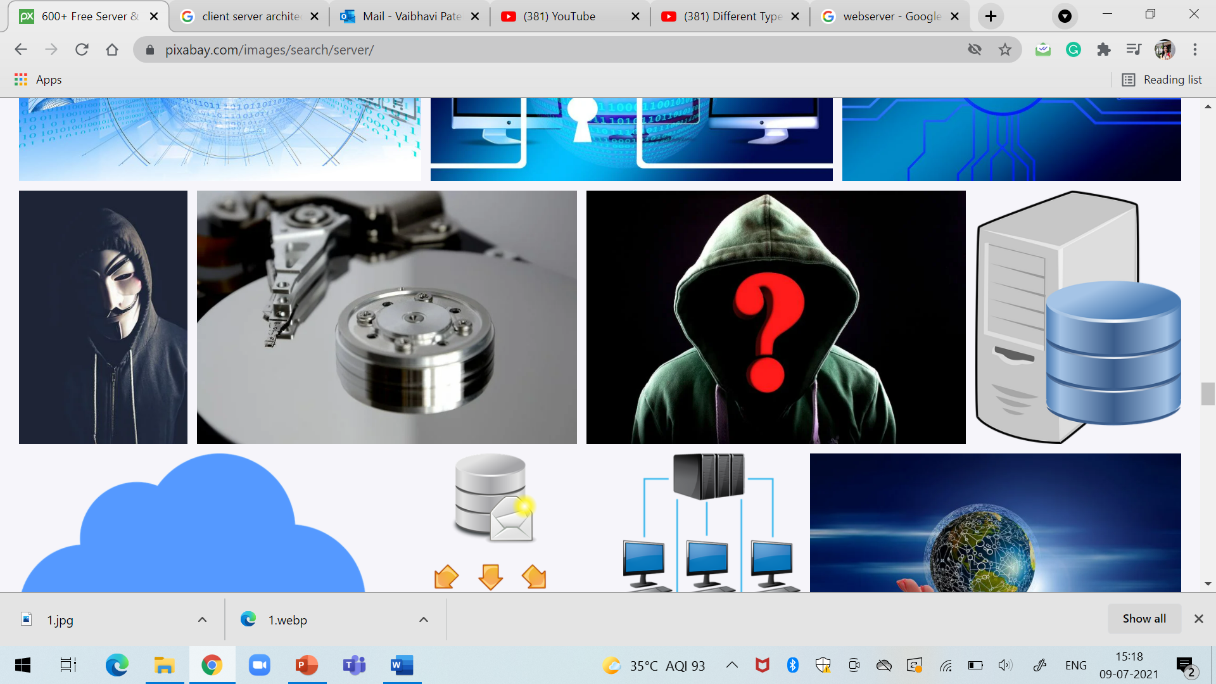
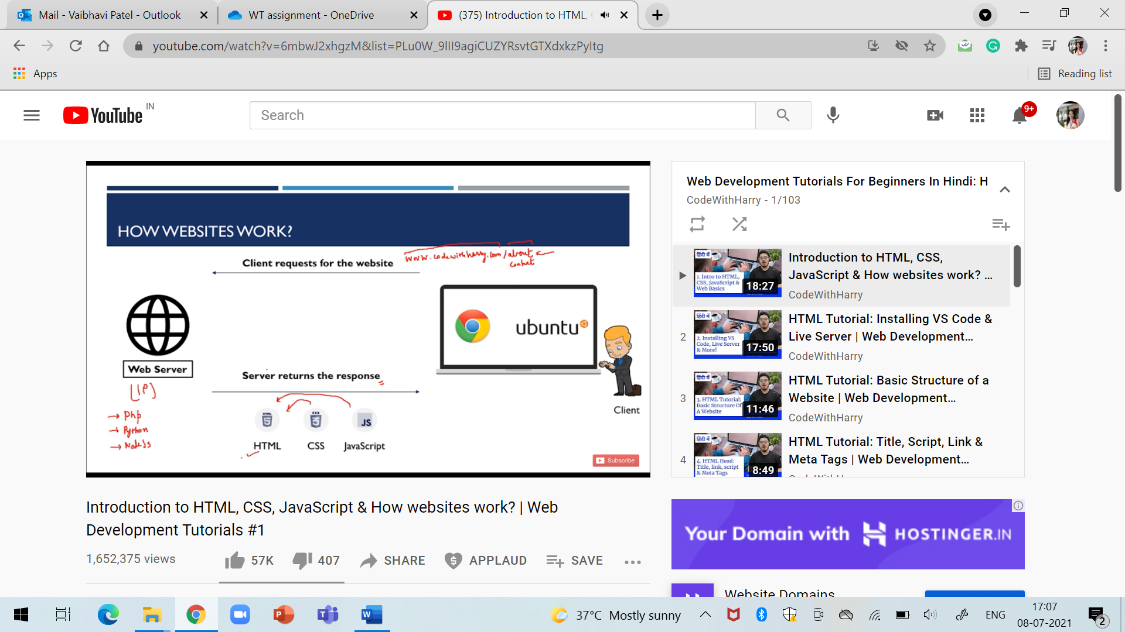
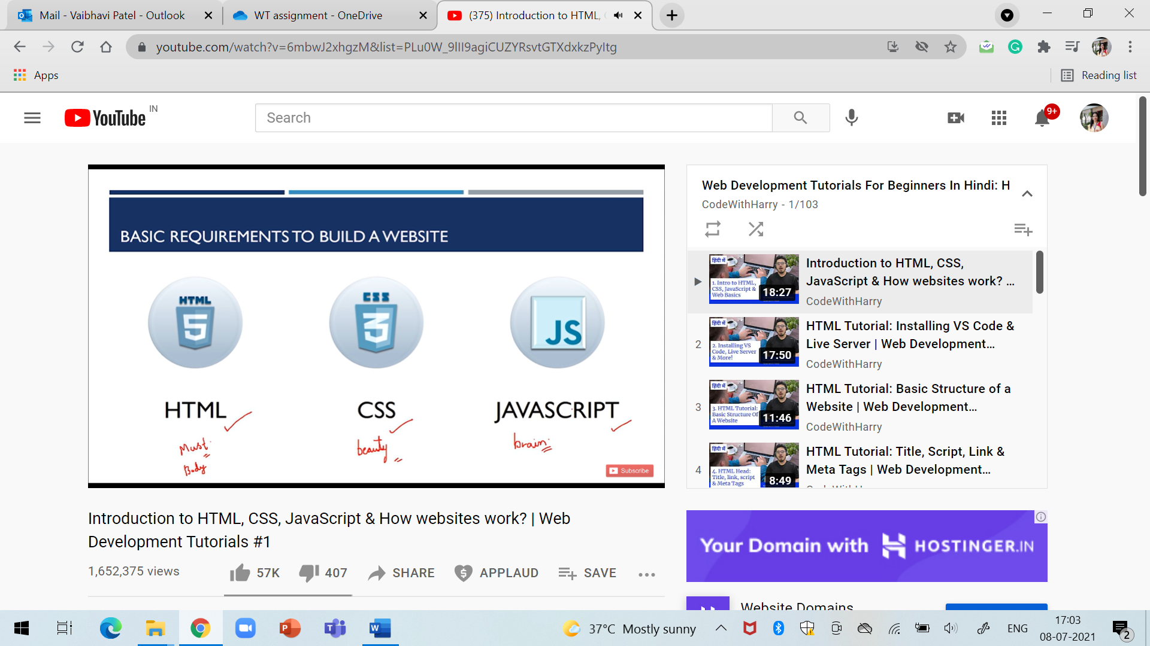
How websites works?
Request
Response

Slide 6
Basic Requirements to develop a website
HTML
CSS
JavaScript
Front-end languages

Slide 7
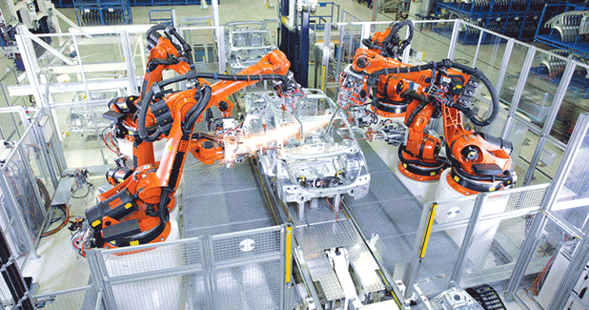

Slide 8
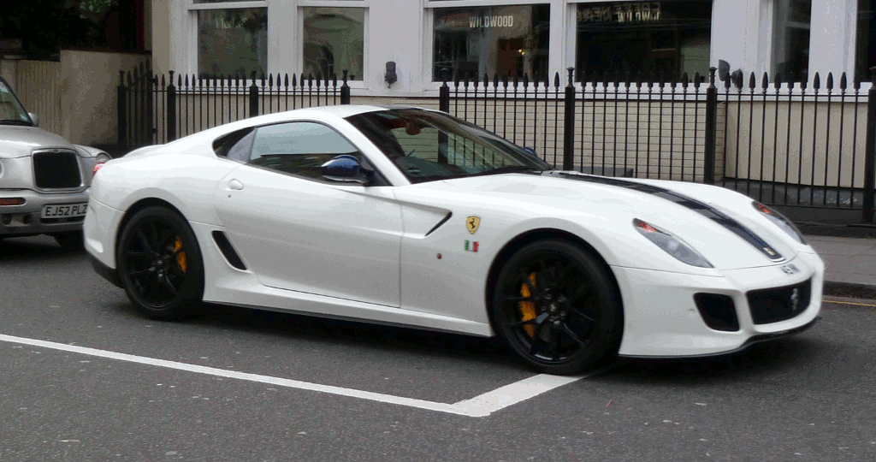

Slide 9
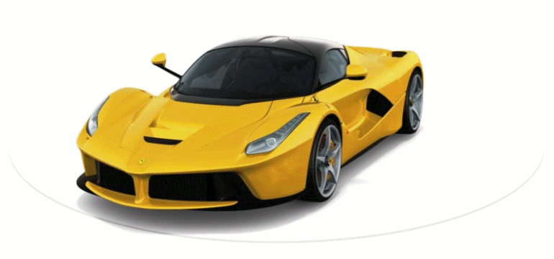

Slide 10
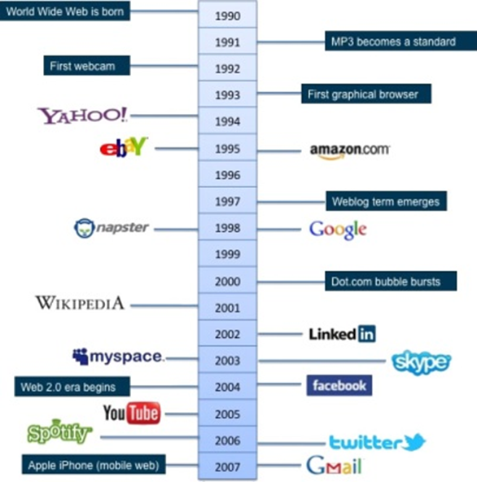
History of Web and Internet

Slide 11
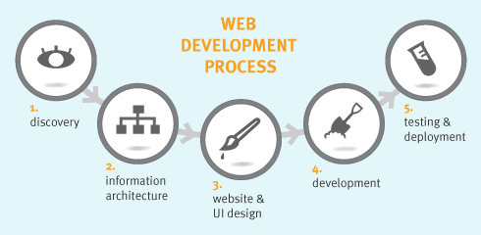
Web Development Strategies

Slide 12
Phase One- Information Gathering
This is the most important phase of website design & development.
Analyzing clients needs & requirements also known as “Discovery phase”.
In this phase, the designer portrays the client’s vision into the paper.
It is also very important to know the goal of the website, which targets audience you want to get targeted, type of content your target audience will look for?

Slide 13
Phase Two – Planning
“Good website is the result of good planning”
Planning is nothing but prioritizing tasks for website completion.
In this phase, we develop the sitemap of the website.
Here, we decide the menus, contents & navigational system for the website.

Slide 14
Phase Three – Designing
This is the creative phase of website design.
Also, communication plays a major role here. The designer needs to understand each & every aspect of the client expectation & try to sketch it.
From logo design to selecting templates everything is discovered in this phase.

Slide 15
Phase Four – Development
Also known as ‘implementing phase’.
This is the phase where your actual website starts its implementation.
All the information that had collected from initial phases will be integrated here.
Creating Database, logic & actual programming is done here.

Slide 16
Phase Five – Testing & Delivery
The testing is done by QA, also responsible for preparing the test cases.
The following are the types of website testing
Content Testing
Functional Testing
Design Testing
After website testing, the files to the server will be uploaded.
The official launch of the website is also made as it is viewable in public now.

Slide 17
Phase Six – Maintenance
Maintenance means updating the contents & design of the website.
The maintenance facility provided for the limited time provided by the company

Slide 18
Protocol governing Web
HTTP Protocol
HTTP stands for Hypertext Transfer Protocol.
HTTP is a communication protocol.
HTTP is
Simple
Extensible
Connectionless
Stateless
Not session less
TCP/IP protocol

Slide 19
Connecting to Internet
Types of Internet service/ Connection Types
Dial-up
This is generally the slowest type of Internet connection
Dial-up Internet uses your phone line

Slide 20
Connecting to Internet
DSL
DSL service uses a broadband connection
Faster than dial-up.
DSL connects to the Internet via a phone line but does not require you to have a landline at home.
Unlike dial-up, you'll be able to use the Internet and your phone line at the same time.

Slide 21
Connecting to Internet
Cable
Cable service connects to the Internet via cable TV.
It uses a broadband connection and can be faster than both dial-up and DSL service;
It uses coaxial cable which is capable of transferring data at much higher speed than common telephone line.
Since Cable TV internet connections share a set amount of bandwidth with a group of customers, therefore, data transfer rate also depends on number of customers using the internet at the same time.

Slide 22
Connecting to Internet
Satellite
Uses broadband but does not require cable or phone lines;
It connects to the Internet through satellites orbiting the Earth.
As a result, it can be used almost anywhere in the world, but the connection may be affected by weather patterns.
Satellite connections are also usually slower than DSL or cable.

Slide 23
Connecting to Internet
3G and 4G service
It is most commonly used with mobile phones.
It connects wirelessly through ISP's network.

Slide 24
Connecting to Internet
Wireless Internet Connection:
Wireless Internet Connection makes use of radio frequency bands to connect to the internet.
It offers a very high speed.
The wireless internet connection can be obtained by either WiFi or Bluetooth.

Slide 25
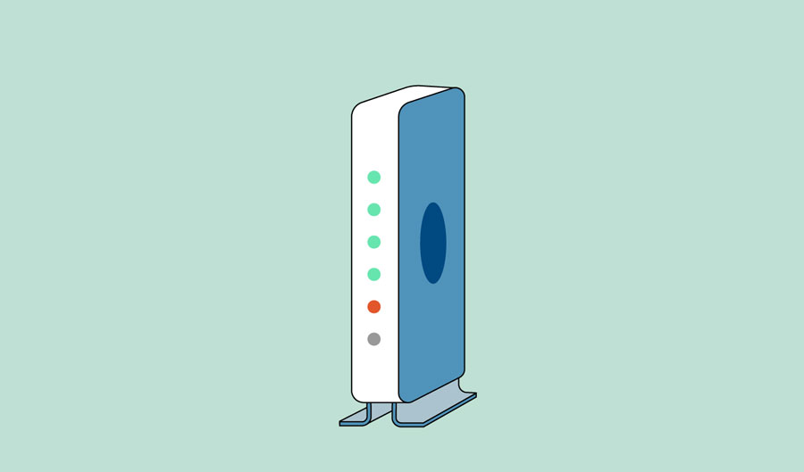
Hardware needed
Modem

Slide 26
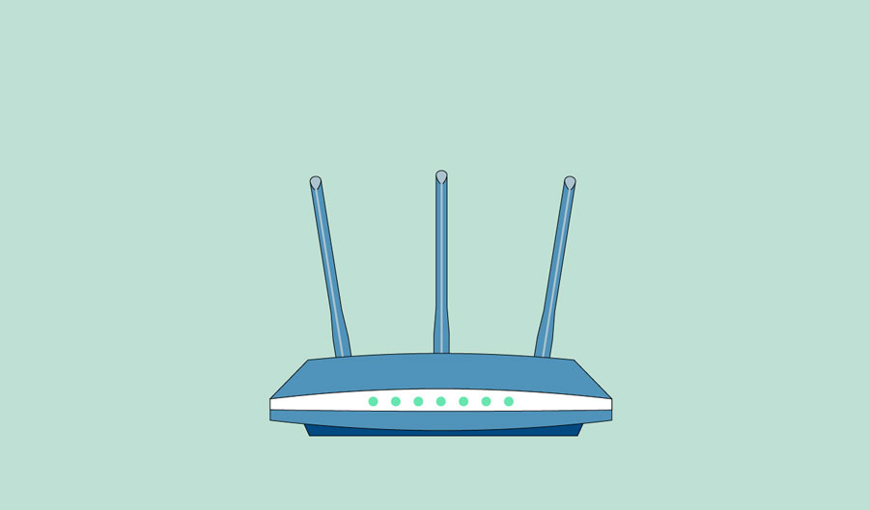
Hardware needed
Router

Slide 27
Introduction to basic Internet services and tools
Introduction to basic Internet services and tools
FTP
Telnet
News
Mailto
etc

Slide 28
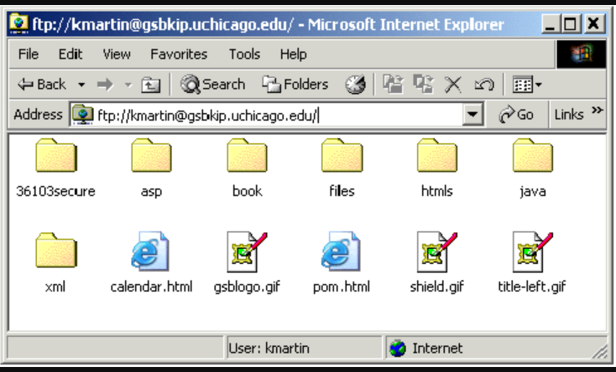
FTP
This existed before HTTP
As the name implies is a protocol for exchanging files over the Internet.
There are two types of FTP: nonanonymous and anonymous.
With nonanonymous FTP, you are required to have an account name and password on the server in order to access files on the server

Slide 29
Telnet
Telnet is the converse of FTP.
With Telnet, you connect to the server machine running Telnet server software and all the computing is done on the server machine.
You cannot Telnet using a browser without this additional client software.
When you Telnet to a server machine, you are given a command line (not GUI) interface to the server machine.
Telnet is often used by systems administrators to connect remotely to computers they are managing.

Slide 30
News
Internet newsgroups are a very common way of exchanging information.
An example news URL is
news://uchinews.uchicago.edu/rec.backcountry
In order to access a newsgroup you need client software and the server needs to be running the appropriate server software.
Newsgroups are asynchronous.

Slide 31
Mailto
Electronic mail, also known as email, is perhaps the most popular Internet protocol.
The mailto tool is similar to Telnet and news, in that you can execute the URL in a browser, but additional client software is needed in order to actually use the tool.
You can also send email using your browser and the mailto protocol.
There is a mail URL for the browser that has the format
mailto:username@company.com

Slide 32
Websites- Static Websites
Static websites are ones that are fixed and display the same content for every user.
This is the most basic form of website, easier to create and perfect for small scale sites.
Static websites usually come with a fixed number of pages that have a specific layout.
A static website is usually created with client-side HTML and CSS in simple text editors like Notepad.
A Static Website also called a flat or stationary page, is displayed in a web browser exactly as it is stored.

Slide 33
Websites- Dynamic Websites
A dynamic website is one that can display different content and provide user interaction.
The dynamic website is more functional.
It allows users to interact with the information that is listed on the page.
Dynamic websites rely on both client-side and server-side scripting languages such as JavaScript, PHP, or ASP etc, also requires database design.
A dynamic website contains information and content that changes.
The content of your site (text/images) is stored on a database or CMS.
When the information is updated or changed within the database, it changes on the site.
Pages are generated on-the-fly (or in real-time) based on the data, also referred to as a database-driven site

Slide 34
Types of Website
Business websites
eCommerce Websites
Entertainment Website
Educational websites
Media Website
Search engines
Portfolio websites / CV websites
Blogs
Social media websites
Brochure
Crowdfunding
TV or video streaming
Internet Forums etc..

Slide 35
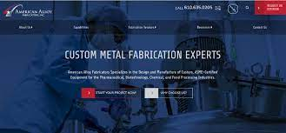
Business websites
A business website is a website designed to represent the identity of a business on the Internet.
There are many reasons why a business might want to be visible on the Internet , including modernity, connectedness, customer service and reliability - and typically to encourage enquiries from potential customers or partners.
It is still the case that not all active businesses have an Internet presence.
It is more important to have your own website if your business has to recruit employees.

Slide 36
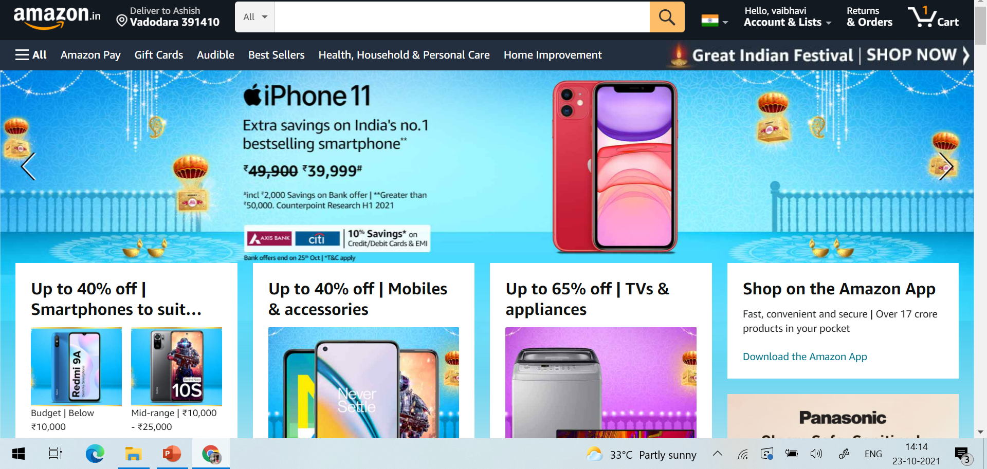
eCommerce Websites
An eCommerce website an abbreviation of Electronic Commerce website.
Designed and set up to allow customers to make purchases of all a business’s products or services directly online including making payment through an online gateway.
This can be done at any time of day or night without requiring a phone call or some other form of direct contact with the business.

Slide 37
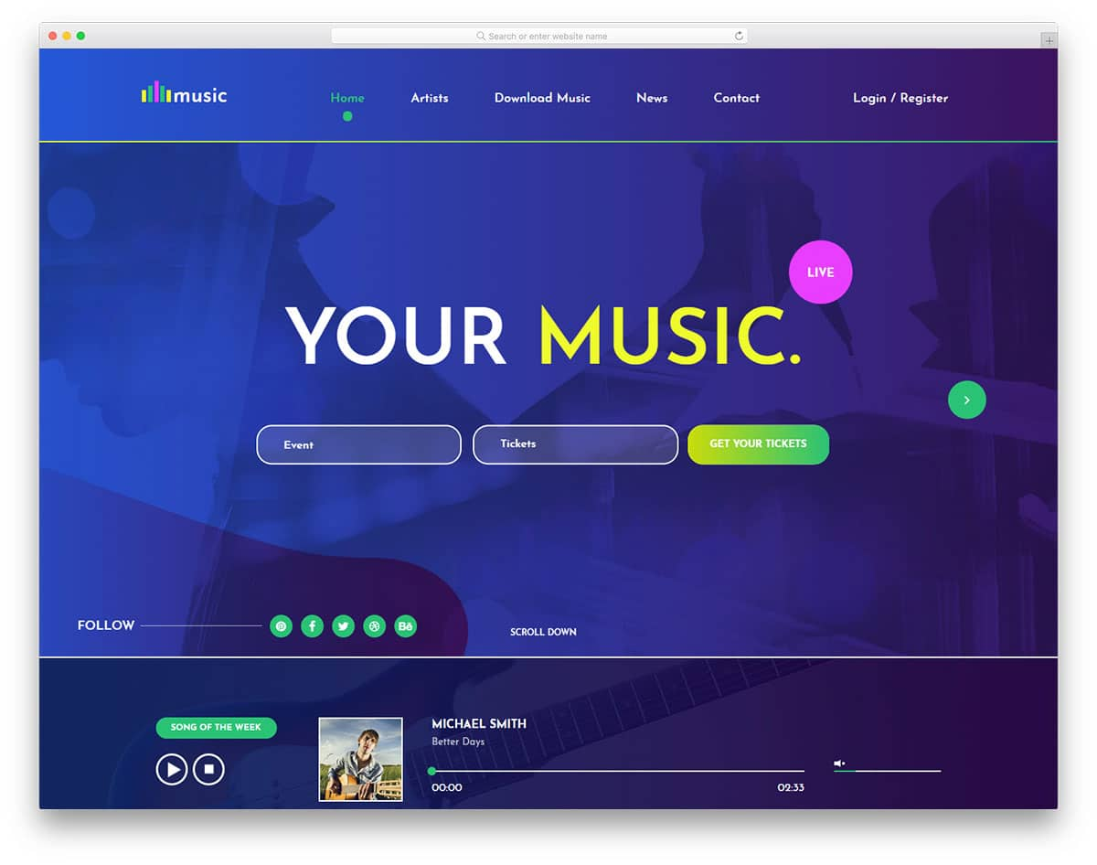
Entertainment Website
An entertainment website is a website that focuses on creating high quality content that is entertaining for the target audience.
It could be anything from information pieces and news to videos, films etc.
Netflix, along with similar sites have changed the way of watching television. People are moving from television to video on demand.
Most of these websites do aim to make money, usually through the advertisements that show up on the page

Slide 38
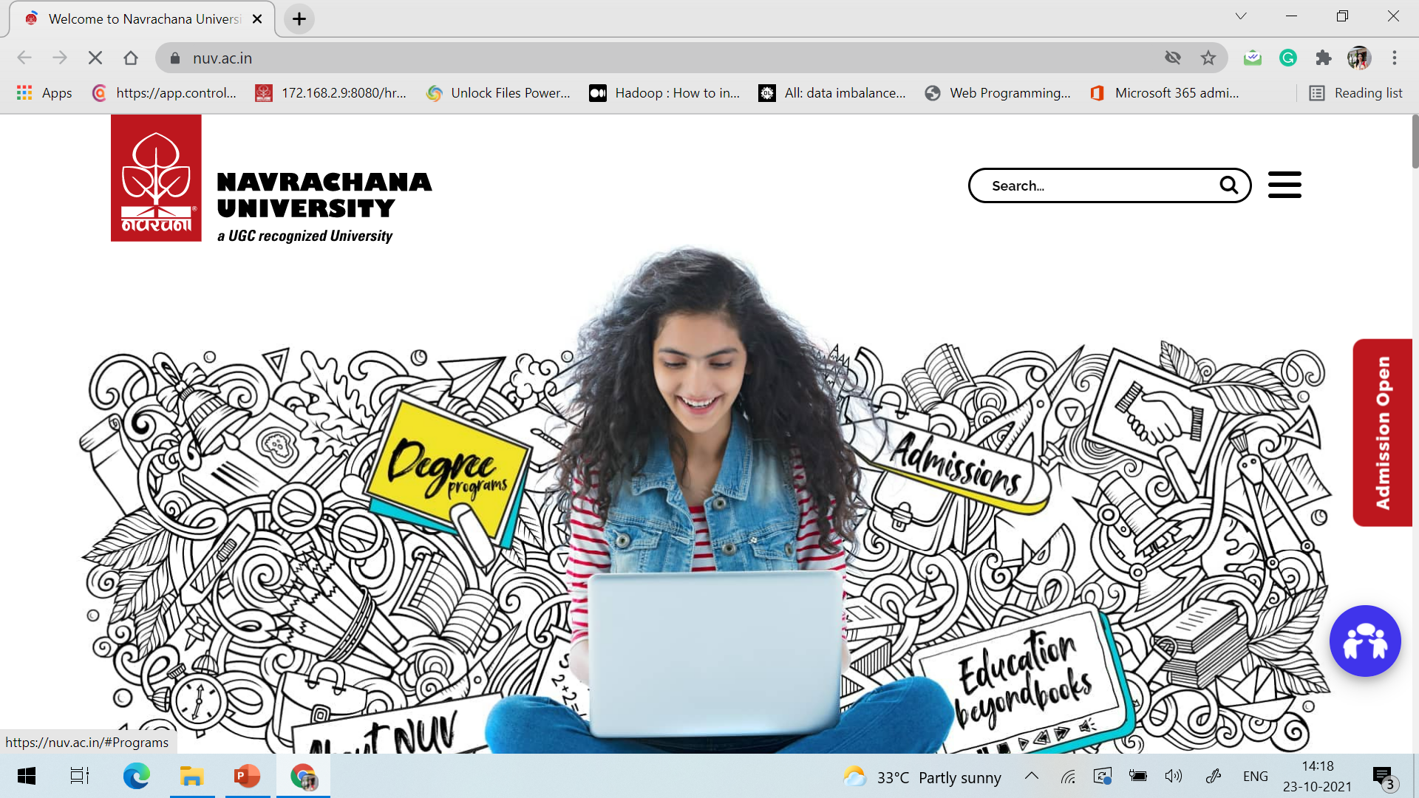
Educational websites
The websites of educational institutions and those offering online courses fall into the category of educational websites.
These websites have the primary goal of either providing educational materials to visitors, or providing information on an educational institution to them.
Some educational websites will have advertisements like entertainment websites do.
Some offer subscription models or educational products for purchase. And some serve as the online presence for an existing institution.

Slide 39
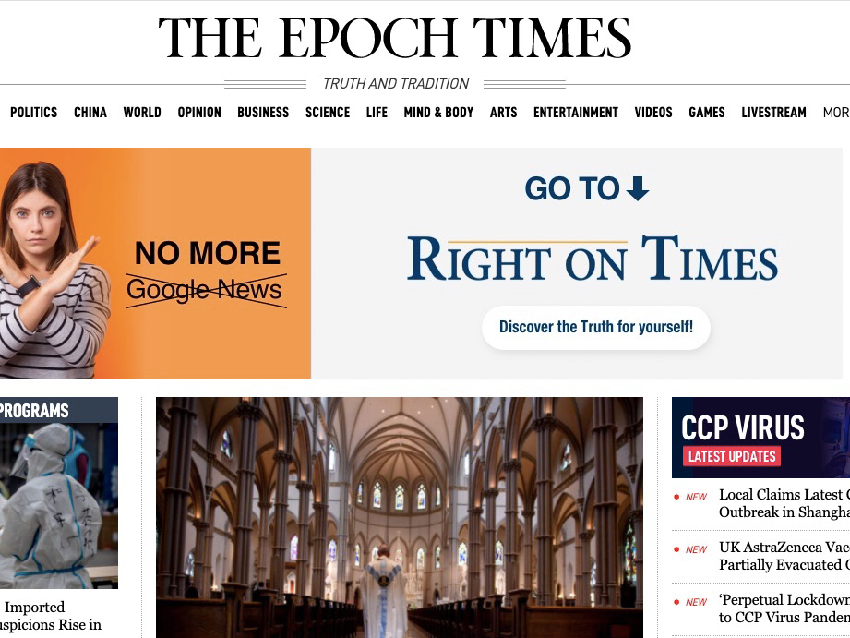
Media Website
Media websites collect news stories or other reporting.
There’s some overlap here with entertainment websites, but media websites are more likely to include reported pieces instead of content meant purely for entertainment.
Many media websites are the online branch of media properties that often exist in other forms, like TV channels or print magazines and newspapers, but some are online only.

Slide 40
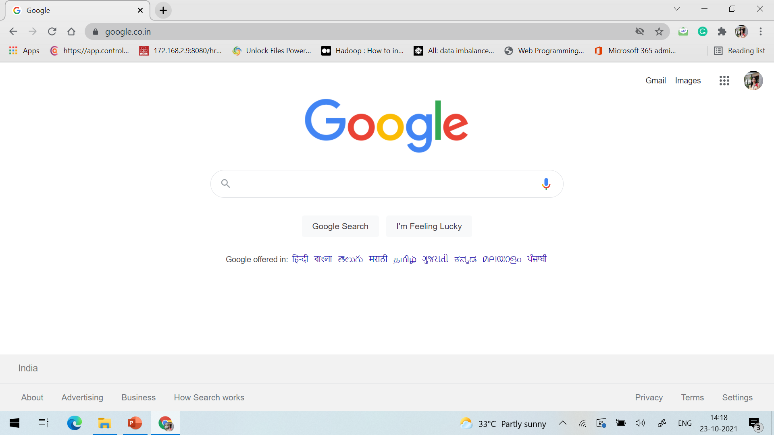
Search engines Website
Search engines are resources serving as keys to finding relevant content on the Internet.
They begin by presenting a blank slate in the form of a search query box into which the user must type text.
Where text input is involved, the search engine is programmed to respond to the user’s word, phrase, series of words or sentence through an algorithm.
Presents the most relevant websites or image results.

Slide 41
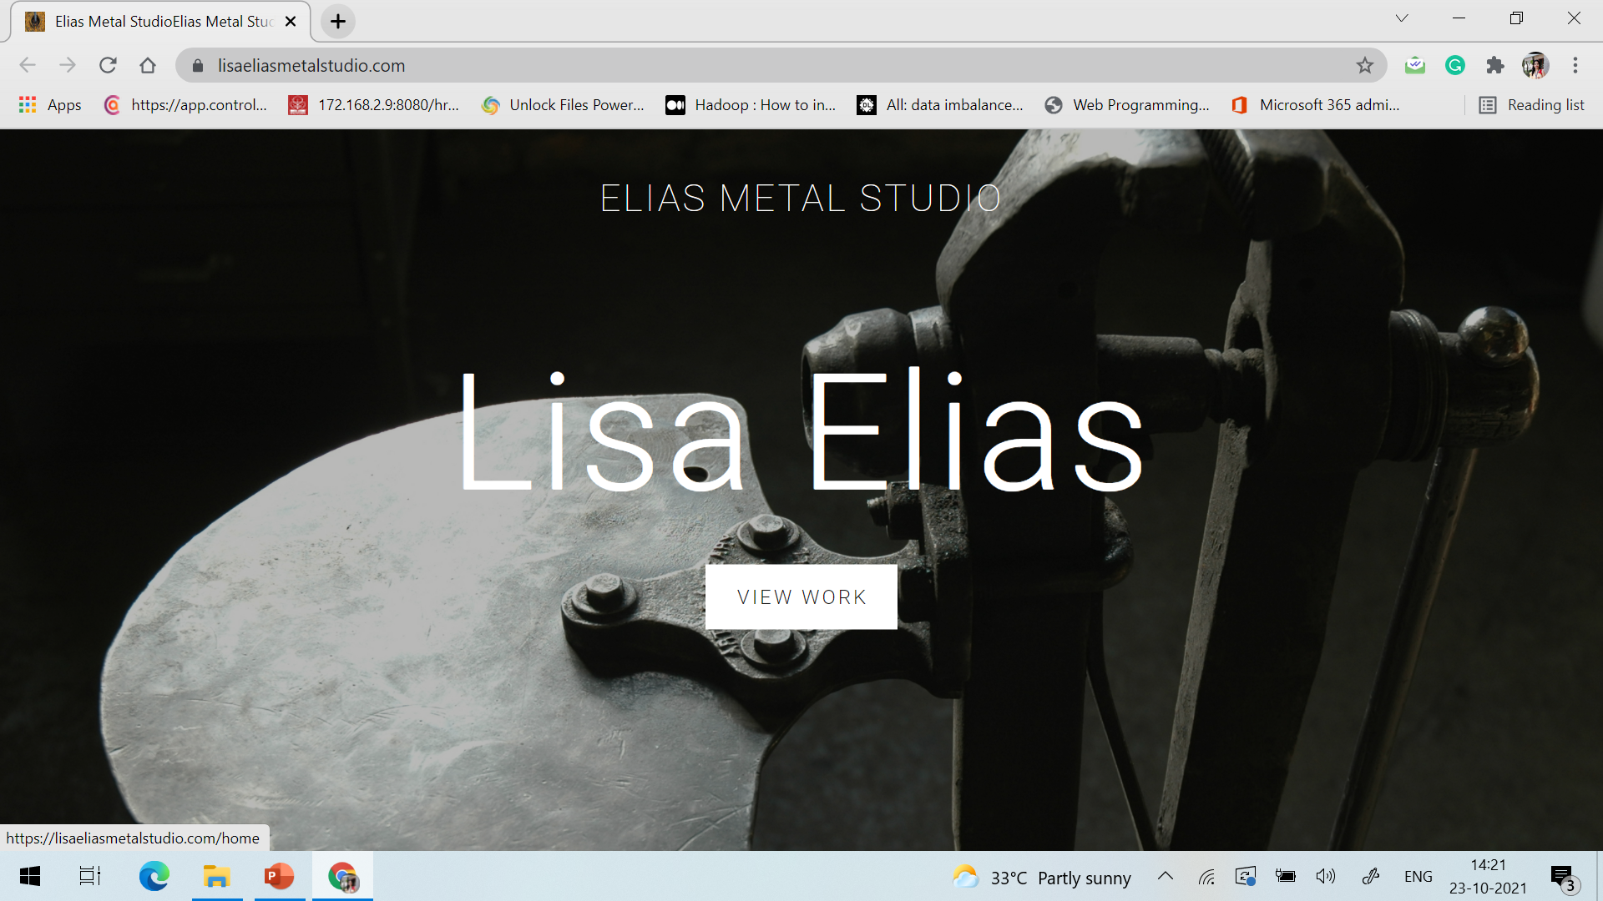
Portfolio websites / CV websites
Portfolio websites are ones serving as a showcase of the work of artists, writers, craftspeople, designers , filmmakers, furniture builders and others working in creative fields.
They will include a gallery of individual’s work, if the work is of a visual nature.
If the work is in written form, it will include abstract of the individual’s written work, and information about any books and other publications that the writer has produced.

Slide 42
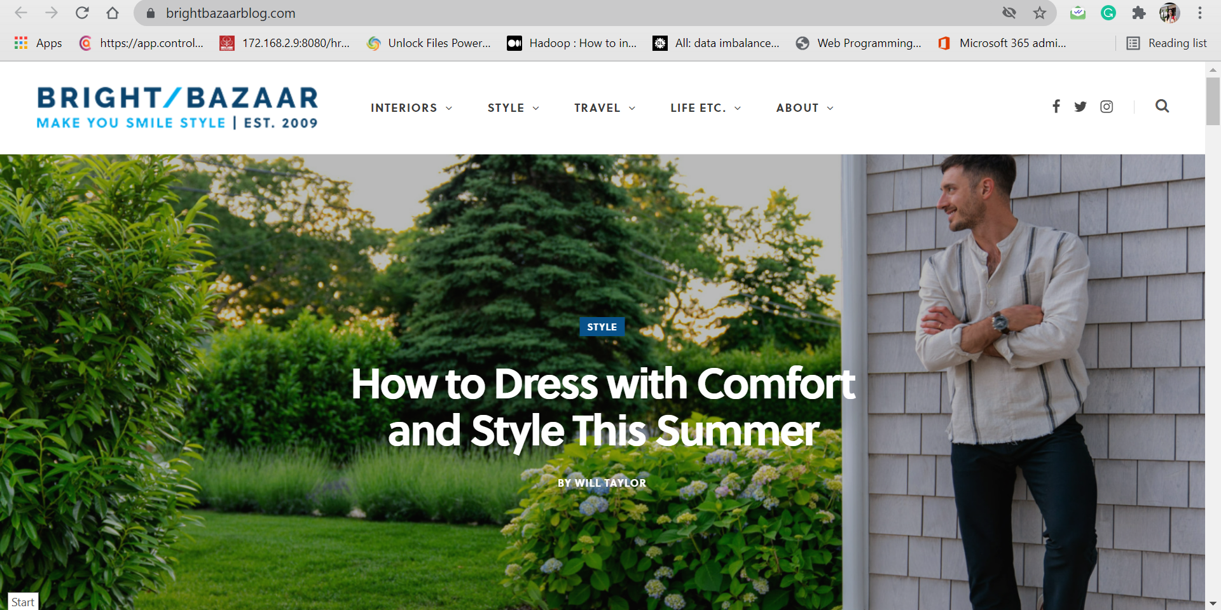
Blogs
A blog features regularly updated articles, photos and videos.
It started with more casual, personal content compared to magazines. But now it’s extremely common for major brands and businesses to have their own blog.
Adding expert content improves the overall credibility of a company or an individual.
Not all websites exist to make money in some way or another. Many people find value in creating personal blogs to put their own thoughts out into the world.

Slide 43
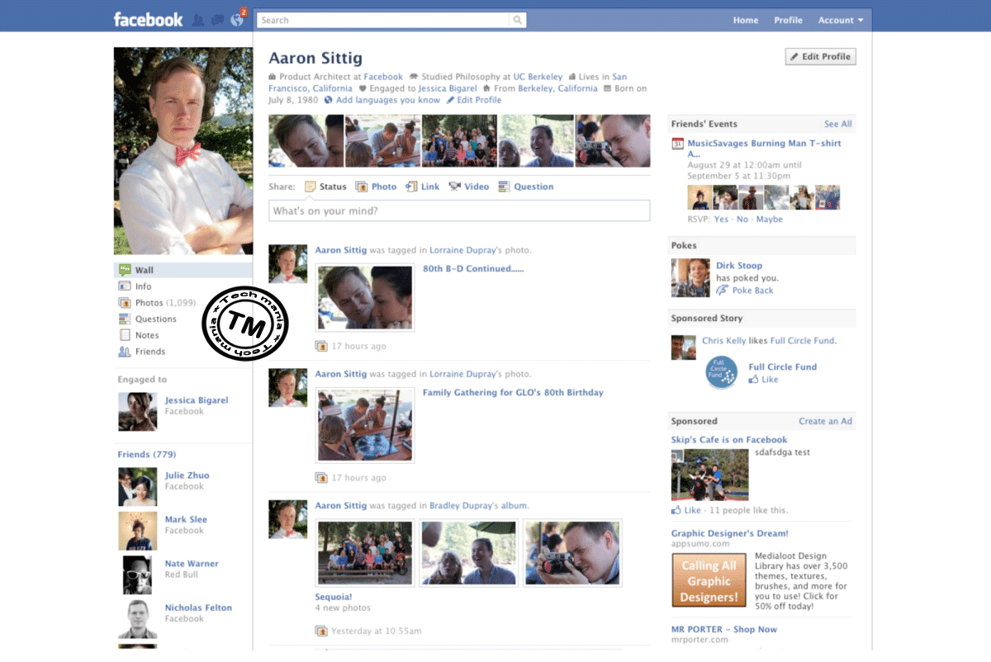
Social media websites
Social media refers to websites that are designed to allow people to share content quickly, efficiently, and in real-time.
There are approximately 2.77 billion people on social media with dozens of different platforms available.
These websites are normally made to let individuals to share pictures or thoughts, or just associate with others corresponding to a specific topic.

Slide 44

Brochure
Brochure websites are like digital business cards.
Mainly used by small businesses, these types of websites are used to advertise services, and to display contact information, with just a few pages.
For example, a small plumbing company would build a brochure website with a homepage to display contact information, an ‘about us’ page describing the company, and maybe a few photos of their work.

Slide 45
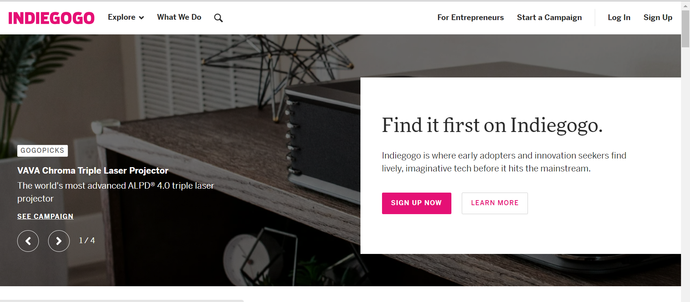
Crowdfunding
Crowdfunding is the practice of funding a project or venture by raising small amounts of money from lots of different people.

Slide 46
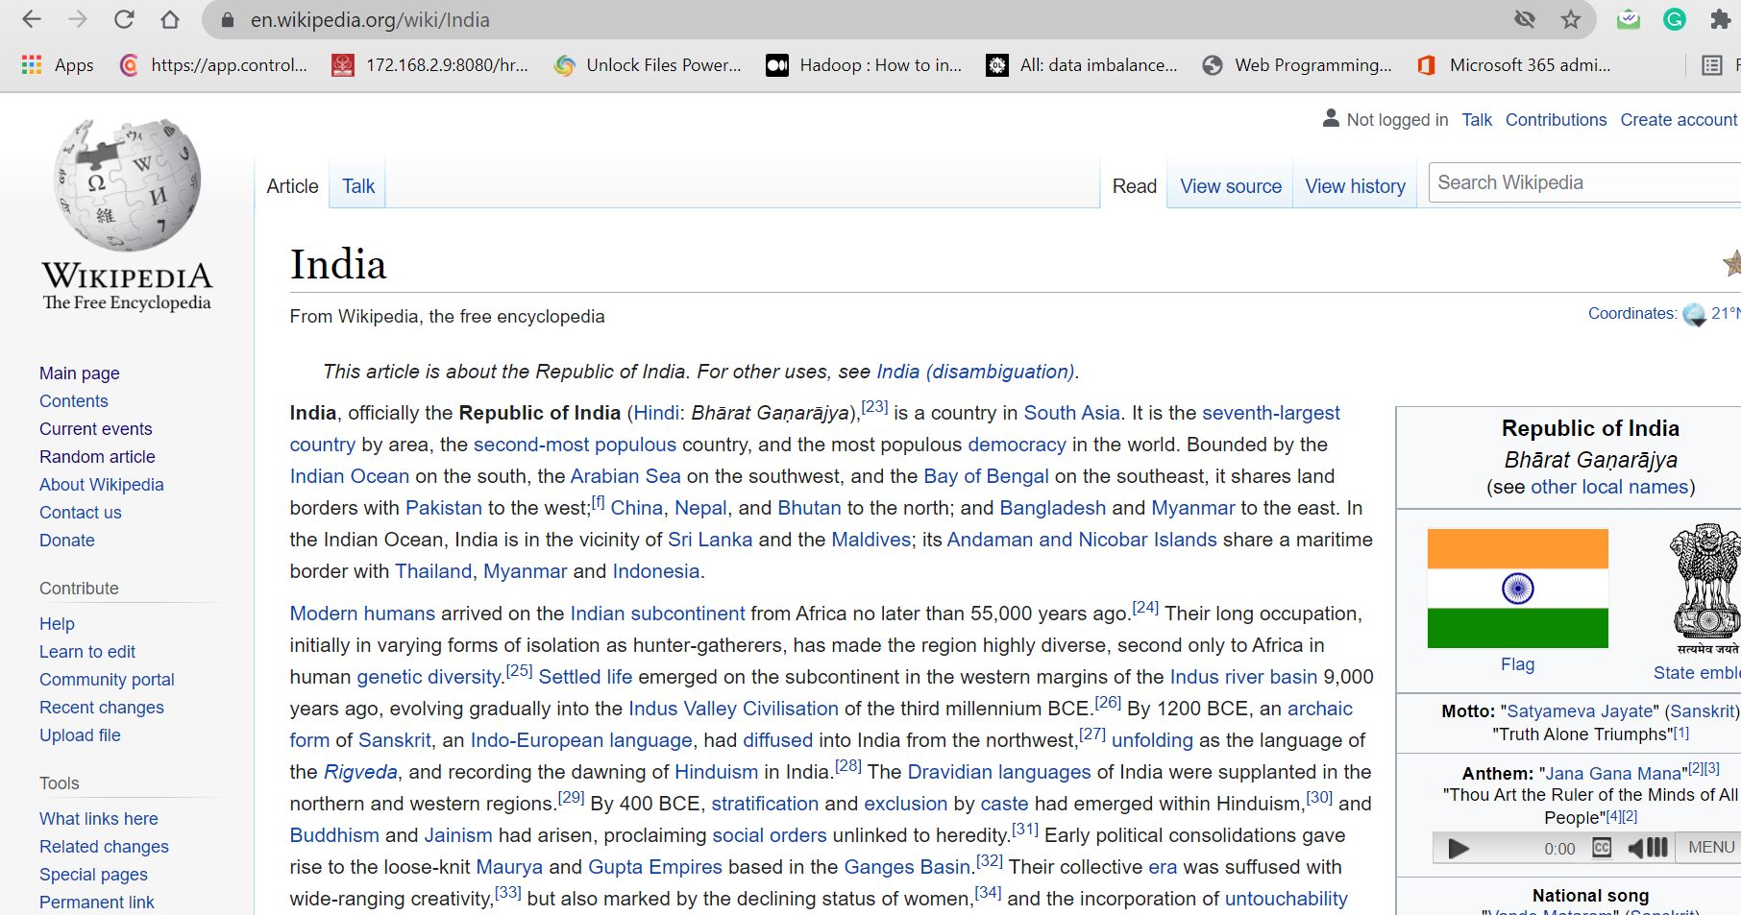
Wiki or community forum
A wiki website allows people to collaborate online and write content together.
The most popular example is Wikipedia itself, which allows anyone to add, modify, assess the content of each article.
Forum types of websites provide an organized way to publish public topic discussions. Users can register so they can start and contribute to discussions.

Slide 47
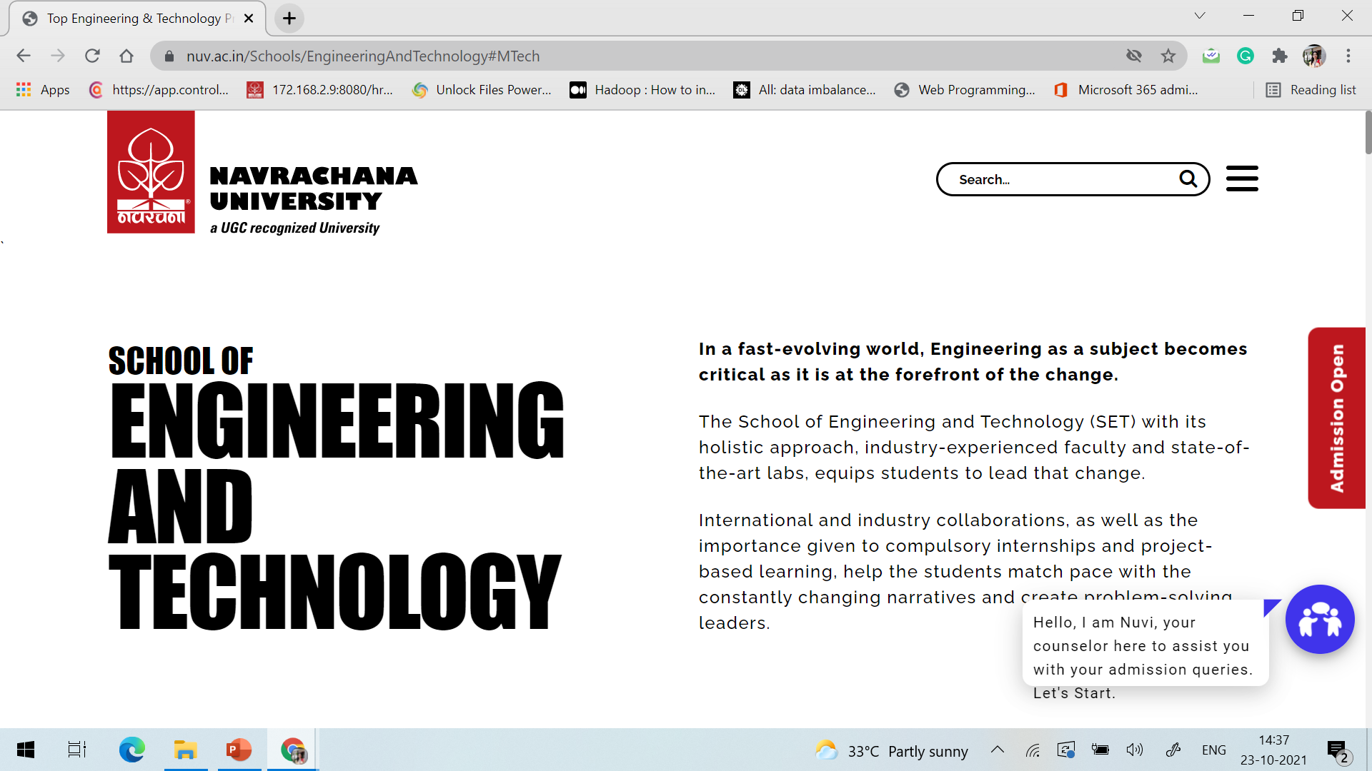

Anatomy of Web Page
The page tile is set using the <title> </title> set of tags in the head section of the html coding. This is the only web page element within the head section of the web page the visitor will see.
Page Title

Slide 48



Anatomy of Web Page
URL
The URL is the domain name of the website. If the visitor just typed www.nuv.ac.in they would be taken to the home page of the website.

Slide 49
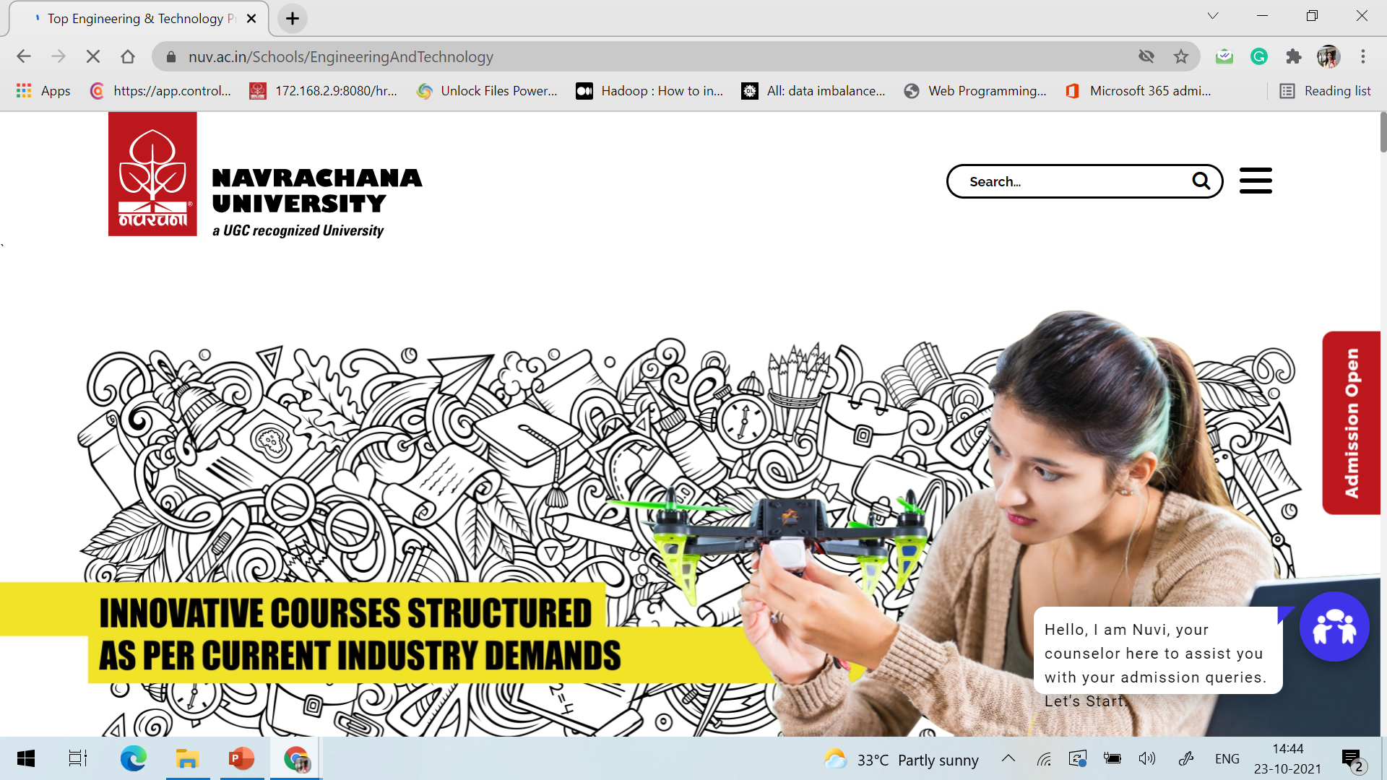


Anatomy of Web Page
File Name
File name is the web page file name. It cannot contain any spaces!

Slide 50
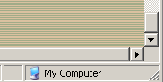
Anatomy of Web Page
Scroll Bars
Scroll bars are on the right side and bottom of the browser window.
If there is a scroll bar at the bottom (horizontal scroll bar) your web page content is too wide for the browser window.
A web page layout should be designed so there is no horizontal scroll bar.
You need to test your web page at different resolutions to see if the page is having horizontal scroll or not.

Slide 51


Anatomy of Web Page
Header
The header is at the very top of the web page. It usually contains a logo for the website.

Slide 52
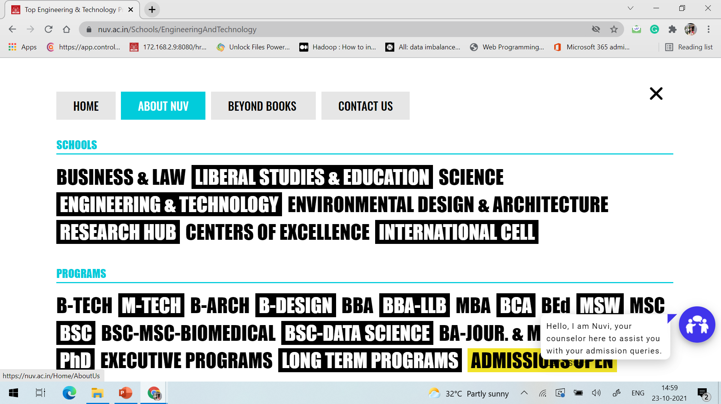
Anatomy of Web Page
Navigation
A website can use a left navigation system, a right navigation system or a navigation system that spans horizontally right under the header or above the header.
The navigation system of a website has to be consistent throughout the website. Changing the navigation system from page to page is confusing to the visitor and they will get frustrated and leave!

Slide 53
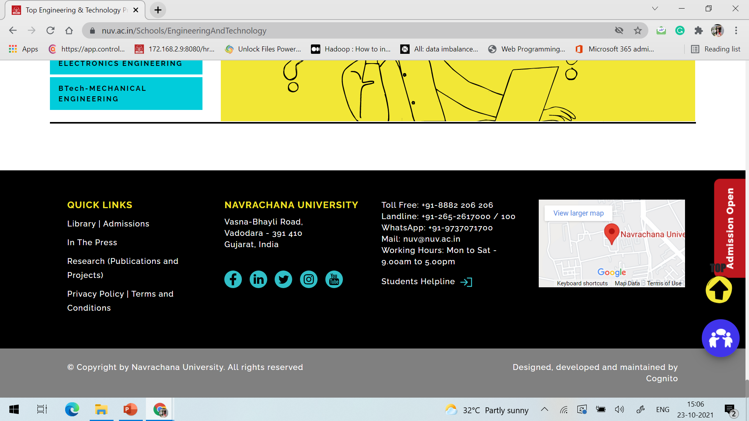
Anatomy of Web Page
Footer
The footer is the bottom section of the web page.
This section is where you usually put your copyright notice, link to your privacy policy and your website contact information.

Slide 54
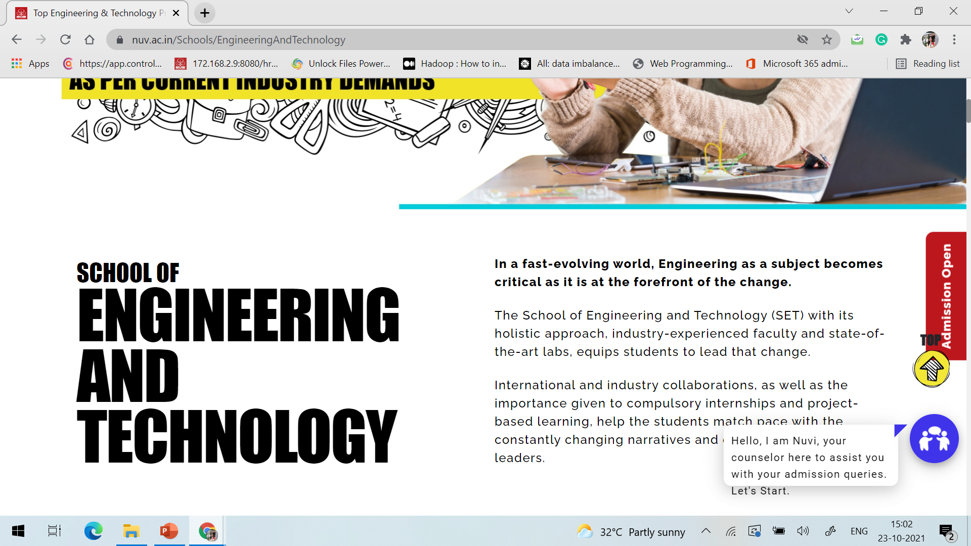
Anatomy of Web Page
Web Page Content
Web page content includes everything between the <body> and </body> tags.
The header, footer and navigation system are also the part of web page content.

Slide 55
Thank You

